Slide 1





Facilitators Guide
SimulatED AI Policy
Designing an AI-Ready District
180 Minute Group-Based Policy Simulation Workshop

Slide 2

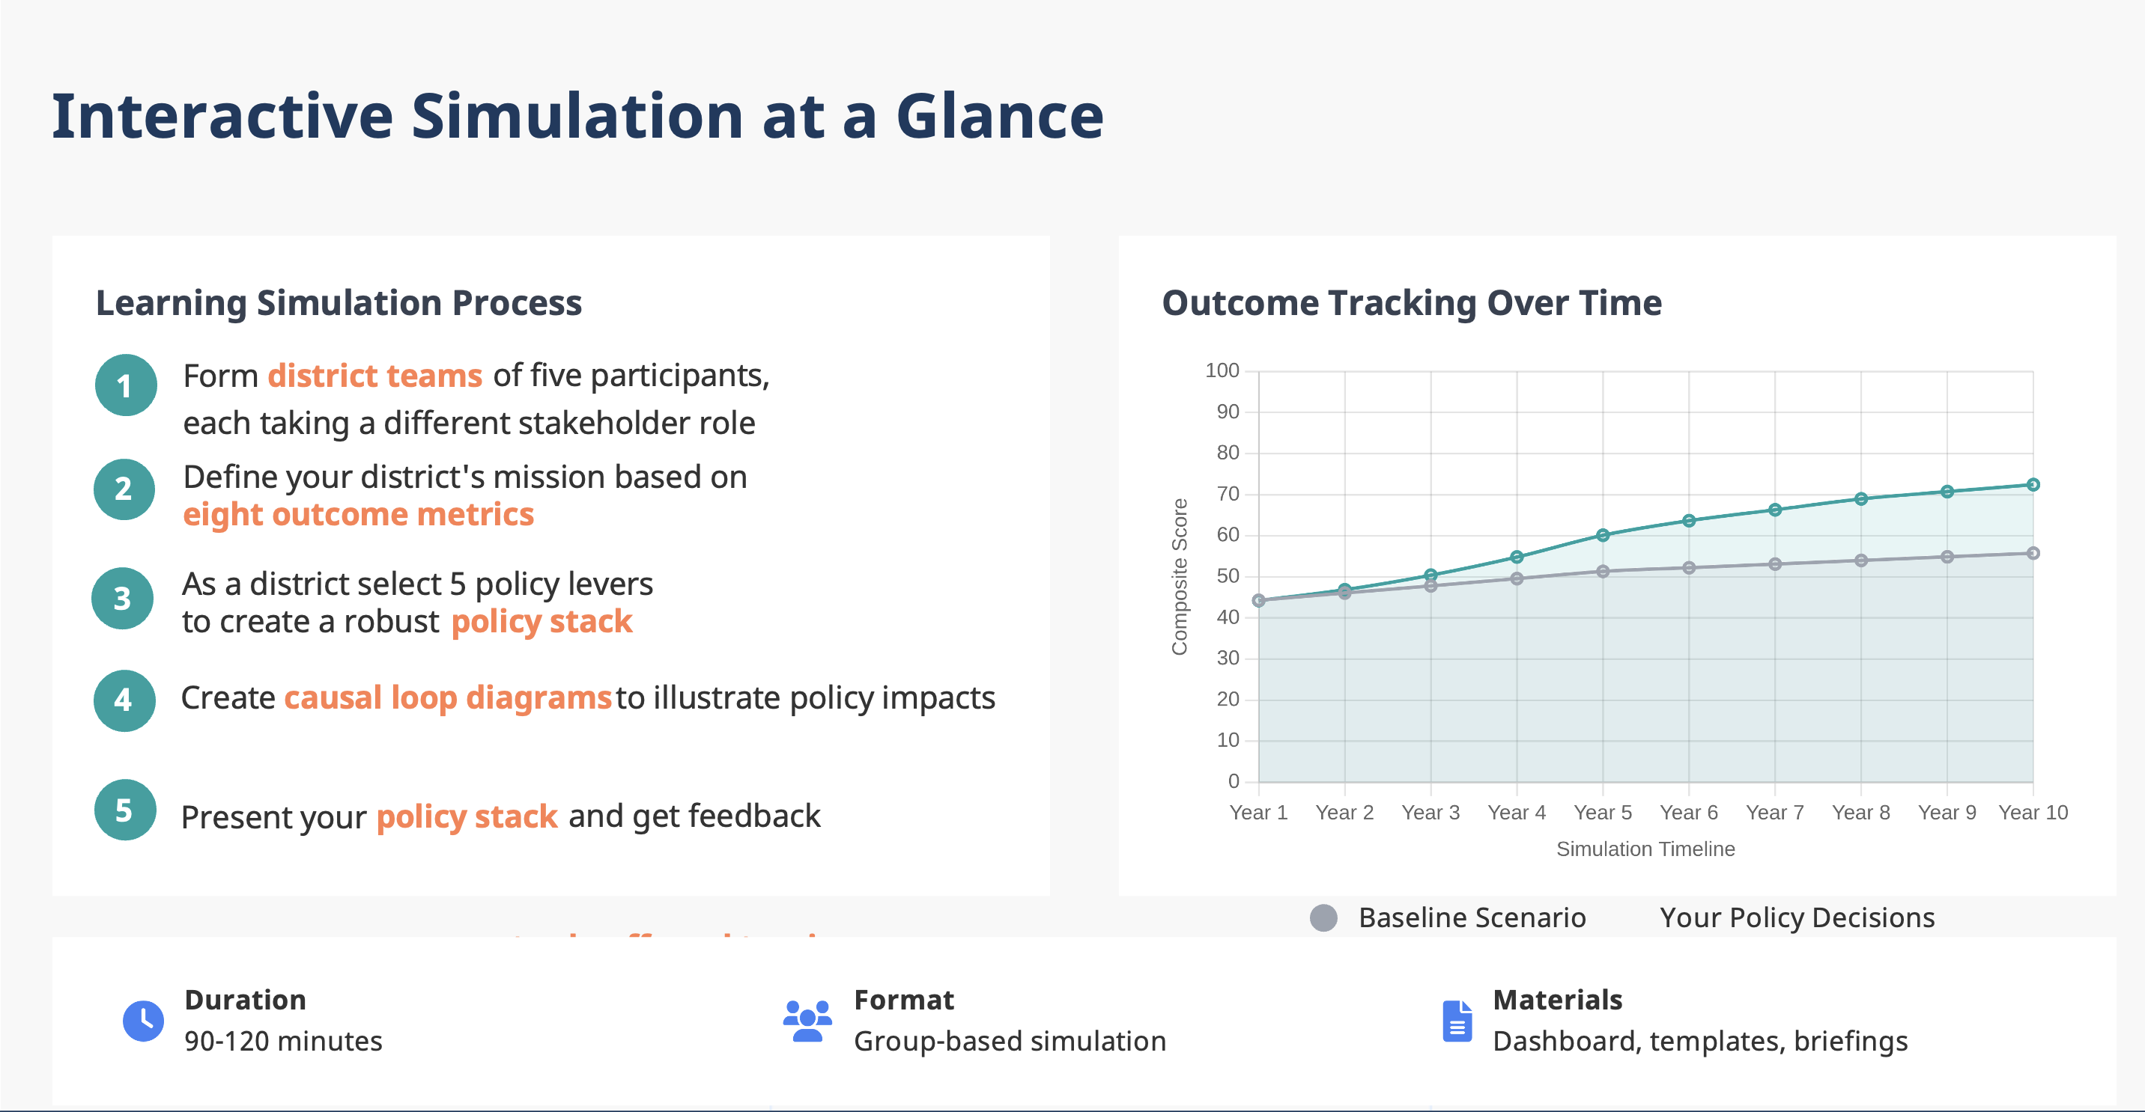
AI Education Policy Simulation
How It Works
Facilitator Notes
Introduce how the learning simulation activity will work in a step-by-step manner
Emphasize that this is a collaborative exercise, not competitive
Say things like:
“You are here to simulate real-world decision-making. There are no perfect answers—only thoughtful trade-offs based on your stakeholder’s priorities.”
“Each of you brings a unique perspective. The simulation works best when all voices are heard and decisions are made collaboratively as a district team.”
Timing: 5 minutes
Designing an AI-Ready District
3

Slide 3
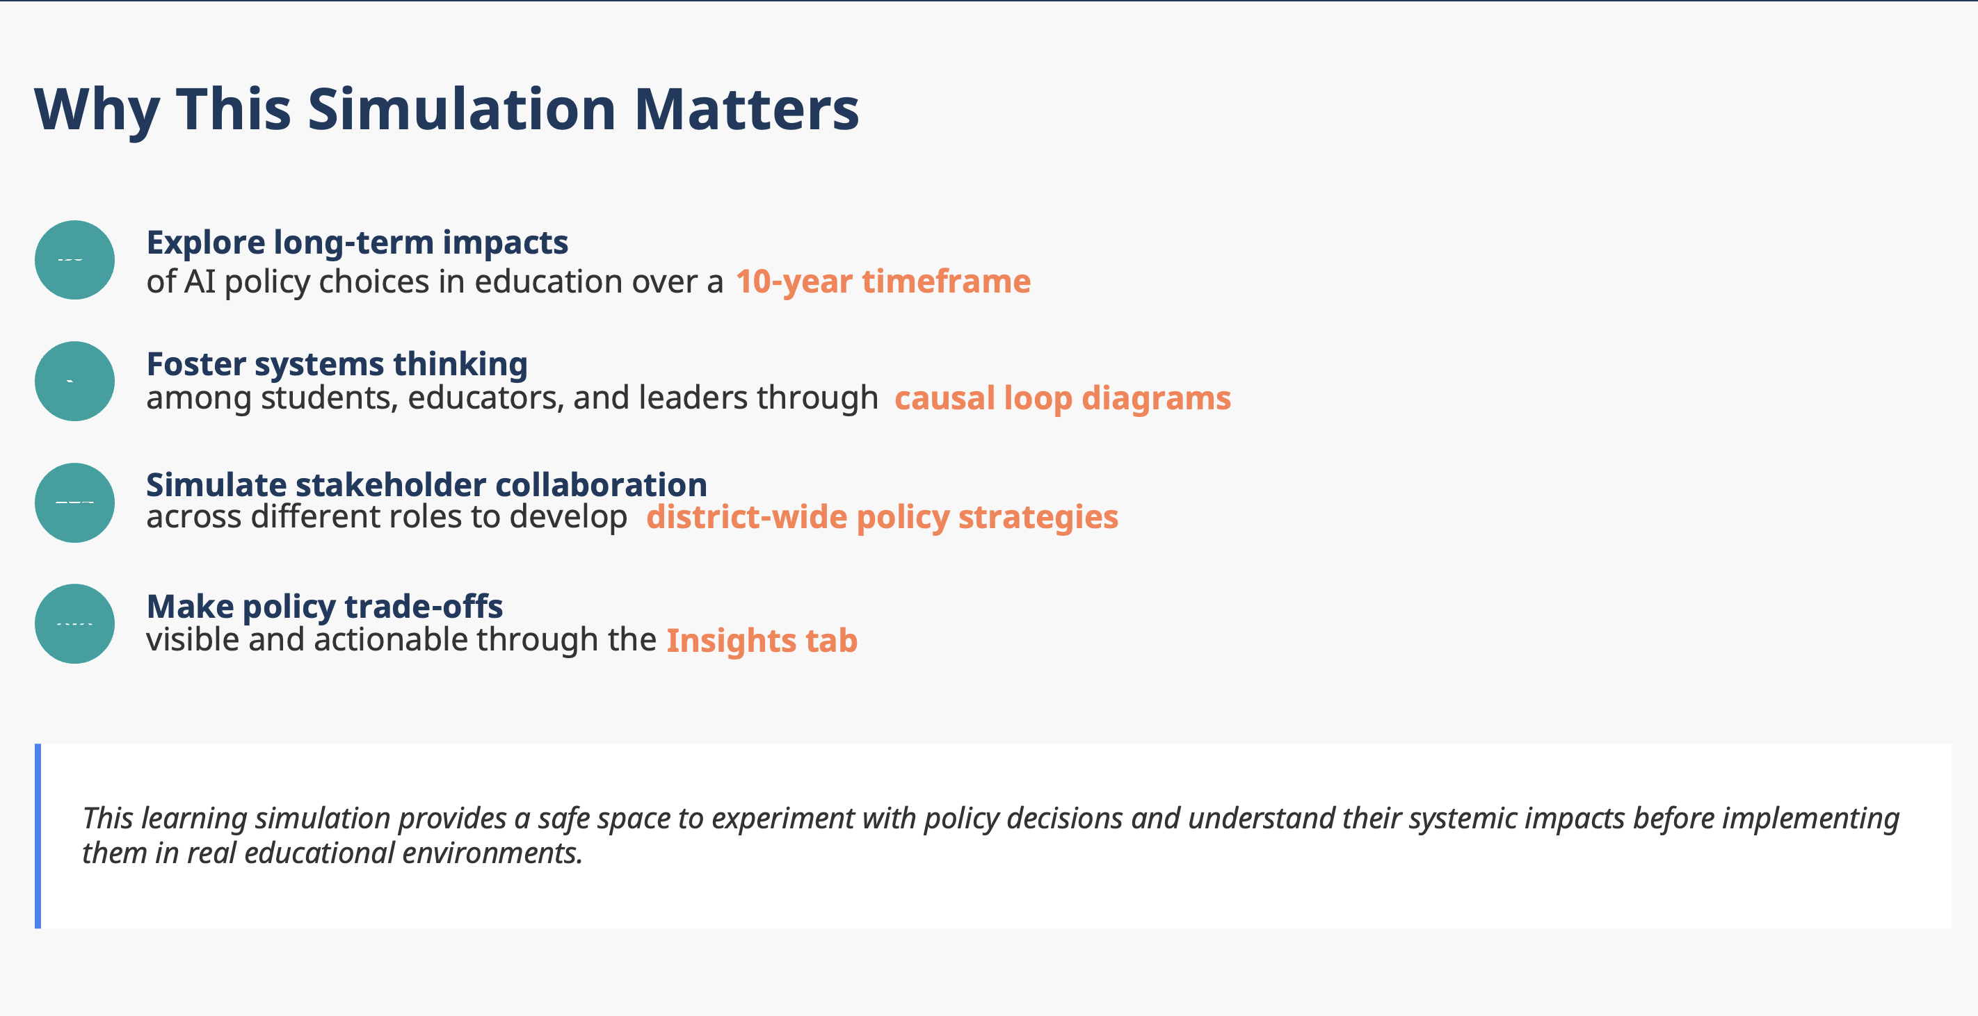
AI Education Policy Simulation
Introduction & Purpose
Facilitator Notes
Emphasize that AI policy decisions have interconnected effects across multiple domains in education, including classrooms, administration, communities, and budgets.
Explain that the simulation is designed to help participants apply systems thinking by examining how policy changes in one area can influence others over time.
Highlight that participants will confront realistic trade-offs, such as balancing innovation with equity or managing budget constraints while trying to boost outcomes.
Clarify that the simulation provides a low-stakes environment for experimenting with policy decisions, allowing participants to test strategies and reflect before applying them in real-life settings.
Timing: 5 minutes
Designing an AI-Ready District
3

Slide 4
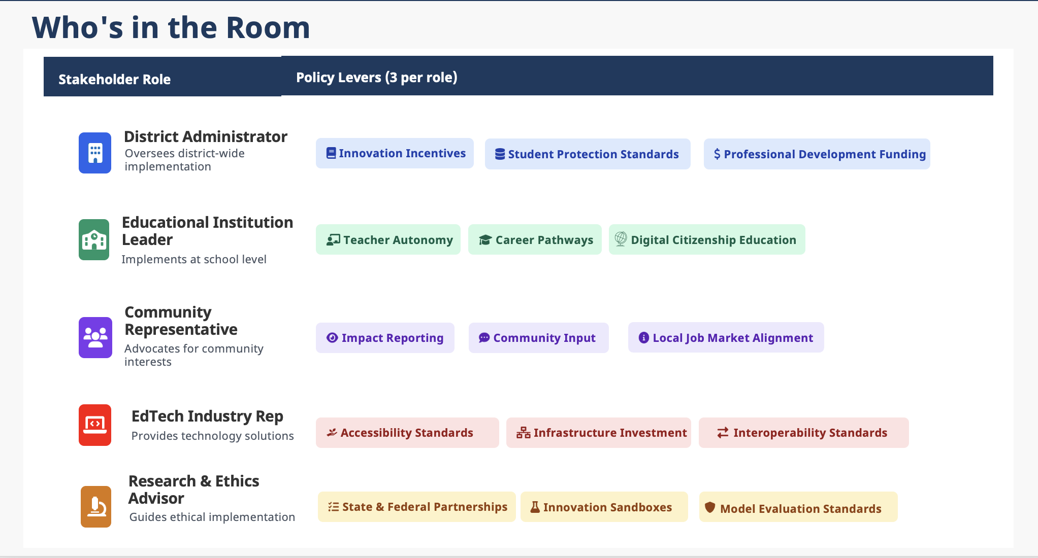
AI Education Policy Simulation
Introduction & Purpose
Facilitator Notes
Divide participants into groups of 5. Each member will adopt one of the 5 stakeholder roles. Ensure groups are mixed in terms of experience/background if possible. Avoid letting participants choose roles based on their real-world jobs - encourage them to step into unfamiliar perspectives
Stress that participants must listen to each other as subject matter experts who must come together to create a robust policy stack. Watch for dominant personalities or participants dismissing others' input. Intervene if one role consistently overrides others. Remind groups that each stakeholder has critical knowledge the others lack
Briefly explain each role and why they're essential to the system. Help participants understand their role's unique perspective without being prescriptive about specific decisions. Emphasize that roles may have conflicting priorities - this tension is realistic and productive
Timing: 10 minutes
Designing an AI-Ready District
3

Slide 5



AI Education Policy Simulation
Policy Lever: Interoperability Standards
Edtech Industry Rep
For Facilitator Only
Interoperability Standards
Potential Synergies with Other Levers
Description
Infrastructure Investment
Innovation Incentives
Educator Autonomy
Common technical specifications that enable different educational software and AI tools to share and reuse data seamlessly. In practice, this means agreeing on data formats, APIs and metadata so that student information systems, learning platforms, and AI tutors can talk to each other. OECD notes that interoperability is “the capacity to combine and use data from disparate digital tools with ease”, and CoSN similarly defines it as the “seamless, secure, and controlled exchange of data between applications” .
Student Protection Standards
Interoperability standards function most effectively with strong technical infrastructure, enabling seamless data transfer across systems while creating a level playing field that encourages innovation by reducing market barriers for smaller companies. These standards expand rather than limit teacher autonomy by ensuring diverse AI tools work together harmoniously, allowing educators to select optimal tools without compatibility concerns, while simultaneously supporting student protection through enforced shared data schemas and consistent security protocols across all integrated AI systems.
Potential Tensions with Other Levers
Why It's Important
Model Evaluation Standards
Educator Autonomy
Interoperability allows educators and systems to integrate AI-driven analytics and learning tools without burdensome manual data entry or one-off workarounds. It increases efficiency by reducing the need of ad-hoc processing to re-input, re-format or transform data, thus making education technology more scalable and cost-effective. In an AI context, standards ensure that data from different sources (e.g. test results, attendance, online activity) can feed AI models accurately and securely, supporting better decision-making and personalized learning.
Interoperability standards may conflict with model evaluation by prioritizing rapid system integration over thorough security assessments and comprehensive AI testing protocols. These standards can also constrain educator autonomy by limiting teachers to "approved" tools that meet compatibility requirements, potentially blocking access to innovative educational technologies that don't conform to established frameworks.
Research & Resources
Interoperability: unifying and maximising data reuse within digital education ecosystems (OECD)
Interoperability is Finally Getting the Spotlight it Deserves (COSN)

Slide 6
AI Education Policy Simulation
Policy Lever: Infrastructure Investment
Edtech Industry Rep
For Facilitator Only
Infrastructure Investment
Potential Synergies with Other Levers
Description
Digital Citizenship Education
AI Career Pathways
Innovation Sandbox
Allocating funds and resources to build and upgrade the physical and network infrastructure (broadband internet, school servers, devices, cloud services, etc.) needed to support AI tools in schools. This includes extending high-speed Internet access, providing modern computers or tablets for students and teachers, and deploying secure servers for AI applications. OECD emphasizes that “connectivity and digital devices are necessary” to realize the full potential of digital learning
Student Protection Standards
Local Job Market Alignment
Infrastructure investment provides the technological foundation for secure student data protection and comprehensive monitoring systems, while enabling reliable access to AI tools necessary for digital citizenship education and hands-on learning. Strong infrastructure supports both local job market alignment and AI career pathways by providing students access to industry-standard tools and training environments. It creates the essential technical foundation for innovation sandboxes to conduct secure, controlled AI experimentation.
Potential Tensions with Other Levers
Why It's Important
Community Input
PD Funding
Innovation Sandbox
Robust infrastructure is the foundation for any AI-enabled education. High-bandwidth, low-latency networks are critical: AI-driven applications like real-time tutoring or virtual labs require “more agile (i.e., smaller latency) communications” (OECD). Without reliable networks and hardware, students and teachers cannot access AI services (cloud-based or on-premise). Infrastructure investment also promotes equity by closing the digital divide, ensuring all schools, both urban and rural, can use AI to improve learning.
Infrastructure investment may conflict with community input when expensive technology priorities don't align with local educational values, while limited budgets force trade-offs between infrastructure spending and professional development funding. Additionally, infrastructure decisions prioritize stable systems that can conflict with innovation sandboxes requiring flexibility to test experimental technologies.
Research & Resources
Hardware: the provision of connectivity and digital devices (OECD)
Navigating the future of AI in education and education in AI (EY)

Slide 7
AI Education Policy Simulation
Policy Lever: Model Evaluation Standards
Edtech Industry Rep
For Facilitator Only
Accessibility Standards
Potential Synergies with Other Levers
Description
Innovation Incentives
Infrastructure Investment
Community Input
Comprehensive requirements ensuring AI tools serve all learners, including translation capabilities for multilingual students, voice-to-text/text-to-voice features for students with disabilities, and executive functioning support tools. Standards mandate the application of universal design principles in AI educational technology. Section 508 standards are harmonized with WCAG 2.0 Level AA for federally funded institutions.
Digital Citizenship Education
Local Job Market Alignment
Accessibility standards synergize with innovation incentives by expanding market opportunities and driving inclusive technology development, while infrastructure investment provides the foundation for implementing accessibility features effectively. Community input ensures standards reflect local needs, accessibility enhances digital citizenship education through inclusive design principles, and supports local job market alignment by helping develop skills for all.
Why It's Important
Potential Tensions with Other Levers
As AI becomes increasingly embedded into educational settings and practices, it offers both opportunities and challenges. Accessibility standards ensure AI reduces rather than amplifies educational inequities. By requiring inclusive design, these standards help multilingual learners, students with disabilities, and those with diverse learning needs fully participate in AI-enhanced education, promoting truly equitable outcomes. The European Accessibility Act requires private sector compliance by June 2025.
Infrastructure Investment
Educator Autonomy
Innovation Incentives
Implementing both accessibility features and robust infrastructure significantly increases expenses, straining budgets and potentially limiting system capabilities. Accessibility standards may constrain educator autonomy by requiring standardized accessible tools over teachers' preferred specialized technologies. Additionally, EdTech companies advocating for accessibility standards may conflict with districts wanting rapid AI deployment, as accessibility-first development takes longer but reaches broader markets.
Research & Resources
AI & Accessibility in Education (COSN)
Where AI meets Accessibility (Every Learner Everywhere)

Slide 8

AI Education Policy Simulation
Policy Lever: AI Curriculum Integration
District Administrator
For Facilitator Only
Innovation Incentives
Potential Synergies with Other Levers
Description
Infrastructure Investment
Student Protection Standards
Career Pathways
Framework of rewards, funding opportunities, and supportive policies encouraging EdTech companies to develop cutting-edge AI educational solutions. Additionally, this comprises funding research and development at every stage of AI integration to help educators and staff make informed, research-based decisions. This includes grants, pilot program partnerships, procurement preferences for innovative tools, and regulatory flexibility for breakthrough technologies. For example, the Education Innovation and Research (EIR) Program, by the U.S. Department of Education.
Local Job Market Alignment
Digital Citizenship Education
Innovation incentives drive infrastructure investment through R&D funding for cost-effective technology solutions and risk-reducing pilot partnerships, while prioritizing funding for breakthrough student protection technologies that ensure compliance through research-backed security innovations. These incentives support development of AI career pathway programs aligned with emerging job markets and fund localized solutions for regional workforce preparation, while driving creation of cutting-edge digital citizenship education tools through dedicated grants for responsible AI use and digital ethics instruction.
Potential Tensions with Other Levers
Why It's Important
PD Funding
Community Input
Accessibility Standards
Innovation incentives may compete with professional development funding for limited resources, potentially deploying breakthrough technologies faster than teachers can be trained to use them effectively. These incentives can conflict with accessibility standards by prioritizing rapid innovation over time-intensive universal design requirements, while potentially overriding community input by imposing external innovation priorities that don't align with local educational values or needs.
Strategic incentives drive continuous improvement in educational AI, ensuring tools evolve to meet emerging needs. Well-designed incentives attract quality vendors, encourage research and development, and foster competition that benefits students through better, more effective learning technologies.
Research & Resources
Learning Lab’s AI FAST Challenge: Funding for Accelerated Study and Transformation
Ed. Startups Get Money, Advice From Federal Program (EdWeek)

Slide 9
AI Education Policy Simulation
Policy Lever: Data Governance
District Administrator
For Facilitator Only
Student Protection Standards
Potential Synergies with Other Levers
Description
Comprehensive framework encompassing data governance, privacy compliance, transparency requirements, explainability standards, and protections against algorithmic bias. Establishes clear guidelines for how AI systems handle student data, make decisions, and ensure fair treatment across all demographics. OECD and other
guidelines stress transparency as essential for trust: high-stakes AI
must allow “verification of accuracy of performance for all
sub-groups” and clear explanation of decision factors .
Community Input
Impact Reporting
Accessibility Standards
Model Evaluation Standards
Student protection standards synergize with community input by addressing stakeholder privacy concerns, while impact reporting provides transparent documentation of protection effectiveness. These standards align with accessibility requirements to protect vulnerable populations and work with model evaluation standards to establish comprehensive safety frameworks assessing both technical performance and student welfare.
Potential Tensions with Other Levers
Why It's Important
Protects student privacy and trust in AI tools. AI systems often require large datasets (e.g. learning profiles, video from classrooms), so clear standards prevent misuse or breaches. NASBE notes that generative AI raises concerns about violating privacy laws like COPPA and FERPA , underscoring why schools need strict data rules. These standards build trust and ensure AI serves students' best interests. They protect vulnerable populations from discrimination, maintain privacy rights, enable understanding of AI decisions affecting students, and create accountability mechanisms essential for ethical AI deployment in education.
Infrastructure Investment
Educator Autonomy
Innovation Sandbox
Student protection standards multiply infrastructure investment costs by requiring security measures to be integrated into all technological capabilities, while restricting innovation sandboxes through comprehensive privacy protocols that limit experimental flexibility. These standards also constrain educator autonomy by limiting teachers' access to preferred AI tools that don't meet institutional privacy requirements.
Research & Resources
Effective AI Requires Effective Data Governance
Opportunities, guidelines and guardrails for effective and equitable use of AI in education (OECD)

Slide 10
AI Education Policy Simulation
Policy Lever: Professional Development Funding
District Administrator
For Facilitator Only
Professional Development Funding
Potential Synergies with Other Levers
Description
Innovation Sandboxes
Career Pathways
Digital Citizenship Education
Dedicated funding streams to train educators (pre-service and in-service) on AI concepts, tools, and pedagogy. This includes workshops, courses or certifications in AI literacy, as well as training on how to integrate AI tools ethically into teaching. The White House Executive Order on AI Education emphasizes that “Professional development programs focused on AI education will empower educators to confidently guide students”. Similarly, policy experts recommend supporting educators in integrating AI with funded PD so teachers understand AI’s capabilities and limitations .
Student Protection Standards
Professional development funding supports innovation sandboxes by training educators for innovative AI curricula, aligns with career pathways through specialized training that creates advancement opportunities, enhances student protection by teaching privacy-compliant practices, and enables effective digital citizenship education through educator preparation for responsible AI instruction.
Potential Tensions with Other Levers
Why It's Important
Teachers are the linchpin of classroom AI use; without proper knowledge, AI tools can be misunderstood or misused. PD ensures that educators know how to select, implement and critique AI tools safely and effectively. It also helps teachers master new AI-integrated curricula and updated assessment methods. Well-funded PD reduces tech anxiety and inequality (so that all teachers, not just tech-savvy ones, can benefit). In short, it turns policy goals into classroom reality by building capacity. Research and reports stress that PD programs can help staff understand AI, its limitations and ethical considerations.
Infrastructure Investment
Innovation Sandboxes
Community Input
Professional development funding competes with infrastructure investment and innovation sandboxes for limited district budgets, as all three require significant resource allocation simultaneously. Both PD funding and innovation sandboxes can multiply costs when experimental programs require additional specialized training for participating educators, while district-determined training priorities may conflict with community preferences for resource allocation.
Research & Resources
AI competency framework for teachers (UNESCO)
Education Policy Outlook 2024 (OECD)

Slide 11

AI Education Policy Simulation
Policy Lever: Assessment Adaptation
Research & Ethics Advisor
For Facilitator Only
State & Federal Partnerships
Potential Synergies with Other Levers
Description
Innovation Incentives
Model Evaluation Standards
Innovation Sandbox
Coordinated research initiatives and resource sharing between local districts and state/federal agencies to address specific educational challenges. Includes collaborative research projects, shared funding mechanisms, best practice dissemination, and policy alignment across governance levels. These partnerships leverage federal research capacity and funding while ensuring local implementation needs and community contexts are integrated into broader educational policy development.
Impact Reporting
Government collaboration enhances innovation incentives by connecting local initiatives with federal funding and regulatory flexibility, while providing essential resources and expertise for innovation sandboxes to conduct sophisticated experimental programs. These partnerships strengthen model evaluation standards through access to federal AI frameworks and comparative data, and enable robust impact reporting through standardized metrics and accountability frameworks that enhance transparency and stakeholder confidence.
Potential Tensions with Other Levers
Why It's Important
Community Input
Educator Autonomy
Local Job Market Alignment
Partnerships leverage collective resources and expertise to solve complex problems individual districts cannot tackle alone. They enable evidence-based policy making, reduce duplication of efforts, accelerate innovation adoption, and ensure local implementations align with broader educational goals.
Government collaboration may conflict with community input when multi-level coordination processes move at different paces than local decision-making, while constraining educator autonomy through research standardization requirements that limit pedagogical customization. These partnerships may also dilute local job market alignment by prioritizing broader state or federal workforce needs over hyper-specific local economic conditions.
Research & Resources
NSF 23-596: Discovery Research PreK-12 (DRK-12)
Research-Practice Partnerships in Education: The State of the Field

Slide 12
AI Education Policy Simulation
Policy Lever: Innovation Sandboxes
Research & Ethics Advisor
For Facilitator Only
Innovation Sandboxes
Potential Synergies with Other Levers
Description
Infrastructure Investment
Model Evaluation Standards
Controlled environments for safely testing experimental AI technologies and policies before full implementation. Allows temporary regulatory flexibility, provides risk mitigation protocols, enables iterative development with real users, and generates evidence for broader policy decisions. OECD describes regulatory sandboxes as a way to allow flexible testing of innovations outside normal constraints .
Digital Citizenship Education
Career Pathways
Innovation sandboxes validate infrastructure requirements and configurations before large-scale investment, while providing controlled environments to test and refine AI evaluation frameworks for broader implementation. These experimental settings pilot innovative digital citizenship curricula for responsible AI use and test new career preparation programs, demonstrating effectiveness before system-wide pathway implementation.
Why It's Important
Potential Tensions with Other Levers
Sandboxes encourage innovation by letting schools try promising AI applications (adaptive learning, new assessment systems, administrative tools) without full risk. They help uncover practical issues (e.g. student privacy, technical glitches) before widescale roll-out. Engaging stakeholders in sandboxes can also generate evidence and best practices. As the OECD notes, sandboxes “promote flexible application or enforcement of policies” for emerging tech. For example, a sandbox might allow a school to test a new AI grading tool with volunteer teachers and students, collecting data to refine both the tool and the policies around it.
Student Protection Standards
Accessibility Standards
Community Input
Innovation sandboxes require experimental flexibility that may conflict with student protection standards limiting data collection and safety protocols, while potentially bypassing community input by prioritizing researcher-determined experimental directions over local preferences. These programs may also test AI prototypes that haven't undergone thorough accessibility compliance, conflicting with universal design requirements.
Research & Resources
The role of sandboxes in promoting flexibility and innovation in the digital age (OECD)
Artificial intelligence act and regulatory sandboxes

Slide 13
AI Education Policy Simulation
Policy Lever: Model Evaluation Standards
Edtech Industry Rep
For Facilitator Only
Research & Ethics Advisor
Model Evaluation Standards
Potential Synergies with Other Levers
Description
PD Funding
Student Protection Standards
Impact Reporting
Comprehensive criteria for assessing AI educational tools across dimensions of transparency, explainability, privacy protection, bias detection, effectiveness, and safety. Includes testing protocols, performance benchmarks, ongoing monitoring requirements, and certification processes informed by latest AI safety research. It also covers requirements for evidence before adopting an AI tool. For instance, the NEA task force advises that “AI technology must only be adopted once data is supporting its appropriateness and efficacy” – either independent research or industry research adhering to rigorous methods .
Infrastructure Investment
Model evaluation standards inform professional development by identifying AI competencies educators need for effective implementation, while validating infrastructure investments by ensuring AI tools perform effectively and identifying technical requirements. These standards provide evidence-based metrics for transparent impact reporting that builds community trust, and ensure AI tools meet safety and privacy requirements by incorporating student protection criteria as core evaluation components.
Potential Tensions with Other Levers
Why It's Important
Such standards are crucial to ensure AI tools are reliable and do not inadvertently harm learning or equity. They hold Edtechs accountable and mandate ongoing evaluation: after deployment, tools should be “reassessed regularly… to ensure [they] continue to enhance, rather than detract from, students’ educational experiences”. This guards against biases (e.g., if an AI grading system favors certain demographics) and unintended side effects. The OECD also highlights that transparent evaluation (with clear metrics and subgroup testing) is key for high-stakes uses. Overall, standards build trust by requiring that AI actually benefits teaching and learning.
Innovation Incentives
Educator Autonomy
Overly rigid model evaluation requirements may slow breakthrough technology deployment, conflicting with incentives for rapid AI innovation and competitive advantage and constrain teacher autonomy by only permitting approved tools, potentially stifling creativity and experimentation.
Research & Resources
Report of the NEA Task Force on Artificial Intelligence in Education
AI TEST, EVALUATION, VALIDATION AND VERIFICATION (NIST)

Slide 14

AI Education Policy Simulation
Policy Lever: Transparency Requirements
Community Representative
For Facilitator Only
Impact Reporting
Potential Synergies with Other Levers
Description
Community Input
Student Protection Standards
PD Funding
A systematic and transparent approach to evaluating AI’s educational impact is essential for building trust among educators, students, families, and policymakers. This includes regularly collecting data on academic outcomes, equity effects, tool usage, and cost-benefit analyses. Findings should be communicated clearly and accessibly through multiple channels such as reports and community updates. The U.S. Department of Education highlights that transparency and open communication about AI’s role, limitations, and outcomes are critical for responsible and effective implementation (OET).
Innovation Sandboxes
Impact reporting enables informed community input through transparent data while demonstrating student protection compliance to address welfare concerns. This reporting validates professional development funding effectiveness by showing training outcomes and identifying support needs, while documenting innovation sandbox results to build community support for continued experimental programs.
Potential Tensions with Other Levers
Why It's Important
Transparent reporting builds community trust and enables informed decision-making. It holds districts accountable for AI investments, reveals whether tools deliver promised benefits, highlights equity gaps requiring attention, and empowers stakeholders to advocate for effective policies. Transparent reporting also enables educational leaders and communities to understand better how AI models function, anticipate their limitations and risks, and ensure that these technologies align with shared goals for high-quality, equitable learning.
Educator Autonomy
Model Evaluation Standards
Impact reporting may constrain educator autonomy by requiring documentation of individual teacher AI usage and effectiveness, creating performance pressure that influences professional decision-making. These reporting requirements may also oversimplify complex model evaluation data when translating technical metrics into accessible community reports, potentially misrepresenting AI tool capabilities.
Research & Resources
AI in Education: Impact Report 23-24
The State of AI in Education 2025 (Carnegie Learning)

Slide 15
AI Education Policy Simulation
Policy Lever: Explainability Requirements
Community Representative
For Facilitator Only
Local Job Market Alignment
Potential Synergies with Other Levers
Description
Career Pathways
Infrastructure Investment
Community Input
Strategic coordination between AI curriculum and regional workforce needs. Includes employer partnerships, skills gap analysis, internship programs, industry-recognized certifications, and regular curriculum updates based on evolving job market demands in AI and related fields. The White House executive order and analysis by Jobs for the Future (JFF) emphasize the importance of embedding AI skills in curricula, aligning education with labor market needs, and supporting apprenticeship and work-based learning models.
Innovation Incentives
Local job market alignment ensures career pathways connect to actual regional employment opportunities, with employers informing AI educational track design. This alignment guides infrastructure investment by identifying necessary AI tools for employment readiness and attracts innovation funding focused on regional workforce preparation. Additionally, local employers provide essential community input on workforce needs that guide AI education planning and curriculum development.
Potential Tensions with Other Levers
Why It's Important
State & Federal Partnerships
Educator Autonomy
Student Protection Standards
Alignment ensures students develop marketable AI skills leading to local employment opportunities. This creates economic mobility pathways, addresses regional talent needs, justifies community investment in AI education, and builds public support by demonstrating tangible career benefits. Ensuring this alignment also helps close the AI literacy divide, so that all regions and populations can participate in—and benefit from—the economic growth and innovation driven by artificial intelligence
Local job market alignment may conflict with government collaboration when federal partnerships focus on broader workforce trends rather than hyper-specific local economic needs. This alignment can constrain educator autonomy by requiring market-driven AI tools that conflict with teachers' pedagogical judgment, while creating tension with student protection standards when local employers prefer data-intensive AI tools that violate educational privacy requirements.
Research & Resources
White House AI Education Plan Aligns With JFF’s Vision, but Resources Are Lacking
Artificial Intelligence: Education Pipeline & Workforce Alignment for National Competitiveness

Slide 16
AI Education Policy Simulation
Policy Lever: Community Input
Community Representative
For Facilitator Only
Community Input
Potential Synergies with Other Levers
Description
Student Protection Standards
Digital Citizenship Education
PD Funding
Formal mechanisms to involve parents, students, teachers and other stakeholders in AI policy. This can include surveys, advisory boards or public forums soliciting feedback before adopting new AI tools or policies. For example, guidance from Wyoming’s education department explicitly asks: “Is there a plan for community input on AI policy and implementation, including feedback from students, parents, teachers, and other stakeholders?”. At a higher level, one study’s policy framework urges that “students should play an active role in drafting and implementing [AI] policy” .
Local Job Market Alignment
Community input informs student protection standards by incorporating parent privacy and safety concerns into policy development, while ensuring digital citizenship education reflects local cultural values about responsible AI use. This input provides workforce insights from local employers that guide AI education planning for regional opportunities, and identifies AI competencies that parents and employers expect teachers to develop, determining professional development funding priorities.
Potential Tensions with Other Levers
Why It's Important
Community input ensures that AI initiatives reflect local values and needs, not just top-down decisions. Involving stakeholders can reveal concerns (e.g. privacy fears from parents, ethical considerations from teachers) that might otherwise be overlooked. It also builds legitimacy: when families and educators feel heard, they are more likely to support AI integration. Importantly, students’ perspectives can highlight usability issues – after all, they are the users. This democratic approach aligns with equity goals (e.g. giving voice to underrepresented groups) and can help identify unintended consequences early.
Innovation Incentives
Educator Autonomy
Innovation Sandbox
Community input may conflict with innovation incentives when local preferences for basic improvements don't align with federal funding for cutting-edge technologies. Community processes may constrain innovation sandboxes by favoring conservative approaches that limit experimental scope, while community demands for specific AI approaches can override educators' professional judgment about optimal teaching methods.
Research & Resources
Bringing Communities In, Achieving AI for All
How to Develop an Effective AI Policy for K–12 Schools

Slide 17

AI Education Policy Simulation
Policy Lever: Educator AI Autonomy
Educational Leader
For Facilitator Only
Educator Autonomy
Potential Synergies with Other Levers
Description
Professional Development Funding
Innovation Sandboxes
Policies that respect and preserve teachers’ professional judgment in using AI. This means giving teachers flexibility to decide if, when and how to use AI tools in their classrooms or assignments. For example, Lake Highland Prep’s AI policy explicitly “grant[ed] teacher’s autonomy to determine if and how the technology fits into the needs of their students and curriculum” . Under such autonomy, administrators set guidelines (like the school’s “Red/Yellow/Green” system), but individual teachers choose usage levels per assignment.
Local Job Market Alignment
Teacher autonomy enables educators to identify relevant AI training that matches their professional development needs while providing feedback on training effectiveness. This autonomy allows meaningful participation in innovation sandboxes by adapting experimental tools to pedagogical approaches, and enables customization of AI instruction based on students' career interests and local employment opportunities.
Potential Tensions with Other Levers
Why It's Important
Student Protection Standards
Community Input
Interoperability Standards
Teachers best understand their students’ needs and can adapt AI use accordingly. Autonomy encourages experimentation and innovation at the classroom level and can increase buy-in (teachers are more willing to use AI if not forced). It acknowledges teachers as professionals, which is crucial in a field historically characterized by top-down mandates. Autonomy can also lead to more creative and context-sensitive uses of AI that rigid policies might overlook. Additionally, it complements efforts to involve teachers in decision-making.
Teacher autonomy may conflict with student protection standards when preferred AI tools don't meet privacy requirements, while tensioning with community input when professional judgment conflicts with community demands for specific approaches. Additionally, autonomy may conflict with interoperability standards when educators prefer specialized tools that don't integrate with standardized district systems.
Research & Resources
MAINTAIN TEACHER AUTONOMY WHILE ADOPTING AI SCHOOLWIDE
Empowering ELA Teachers: Recommendations for Teacher Education in the AI Era

Slide 18
AI Education Policy Simulation
Policy Lever: AI Career Pathways
Educational Leader
For Facilitator Only
AI Career Pathways
Potential Synergies with Other Levers
Description
Local Job Market Alignment
Infrastructure Investment
PD Funding
Initiatives that create clear educational-to-career routes in AI and related fields. Examples include specialized high school programs (like AI magnet schools), partnerships with industry for internships, and guidance counseling that highlights AI-related careers. These programs might integrate AI into career-technical education or offer certifications (e.g. AI foundations certificates). The goal is to ensure students, especially from underrepresented groups, can smoothly transition into AI jobs or further STEM education.
Innovation Sandboxes
Career pathways require professional development funding to train teachers in AI industry standards, while connecting to local job market alignment through regional employment opportunities and employer partnerships. These pathways benefit from innovation sandboxes that pilot new workforce development approaches and require infrastructure investment in industry-standard AI tools that provide authentic workplace preparation environments.
Potential Tensions with Other Levers
Why It's Important
As AI transforms the workforce, schools must prepare students with the skills employers need. Career pathways signal to students that AI literacy has real-world value and can motivate learning. They also address equity: by building accessible pathways (through community colleges, alternative credentials, etc.), all students can share in AI opportunities. Policy efforts are already underway – for instance, a consortium of U.S. colleges is developing national AI standards to “better align career and technical education with core academic disciplines relating to tech career pathways” . This lever bridges K-12 learning with higher-ed and industry needs.
Community Input
Educator Autonomy
Student Protection Standards
Career pathways may conflict with community input when parents prefer comprehensive education over specialized AI preparation, while constraining educator autonomy by dictating specific curriculum that limits pedagogical flexibility. These pathways may also tension with student protection standards when industry-focused programs require workplace AI tools with data collection that violates educational privacy requirements.
Research & Resources
Riding the AI Wave: What’s Happening in K-12 Education?
Career education evolves to meet emerging technology demands

Slide 19
AI Education Policy Simulation
Policy Lever: AI Usage Guidelines
Educational Leader
For Facilitator Only
Digital Citizenship Education
Potential Synergies with Other Levers
Description
Professional Development Funding
Innovation Sandboxes
Implementation of a comprehensive curriculum addressing responsible AI use, including ethical decision-making, privacy awareness, critical evaluation of AI-generated content, understanding of AI bias, and skills for safe, effective participation in an AI-augmented digital world. UNESCO's AI Competency Framework for Students (2024) defines four core competencies: human-centered mindset, AI ethics, AI techniques, and AI system design. The OECD AI Literacy Framework (2025) emphasizes responsible AI engagement through four domains: Engaging with AI, Creating with AI, Learning about AI, and AI in Society.
Community Input
Digital citizenship education requires professional development funding to train teachers in responsible AI instruction and digital ethics pedagogy. This education incorporates community input by reflecting local cultural values and parent expectations about responsible technology use, while providing the ethical foundation for students to participate safely in innovation sandboxes through informed consent and responsible use principles.
Potential Tensions with Other Levers
Why It's Important
Career Pathways
Educator Autonomy
Local Job Market Alignment
Digital citizenship education may constrain educator autonomy by imposing standardized ethical instruction that conflicts with teachers' preferred subject integration approaches. This education can tension with local job market alignment when ethical standards don't match efficiency-focused industry practices, while competing with career pathways when ethics instruction time reduces technical skill development for workplace readiness.
Digital citizenship prepares students to navigate AI's complexities throughout life. It develops critical thinking about AI claims, protects against manipulation and misinformation, promotes ethical technology use, and empowers students as informed digital participants rather than passive consumers.
Research & Resources
What you need to know about UNESCO's new AI competency frameworks for students and teachers
Digital Citizenship in Education (ISTE)

Slide 20
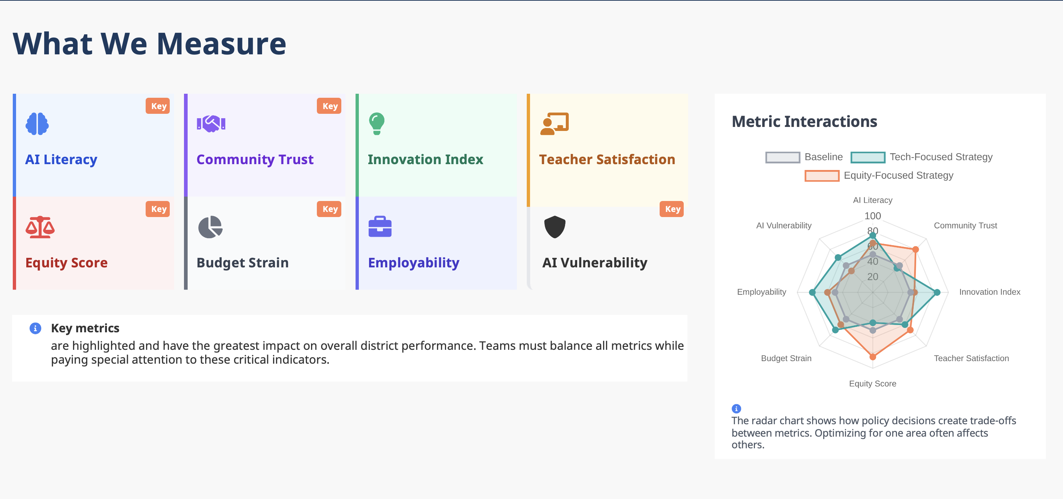
AI Education Policy Simulation
Introduction & Purpose
Facilitator Notes
Present the 8 outcome metrics as the "scoreboard" for district performance that stakeholders will judge you on. Emphasize that they represent real impacts on students, teachers, families, and community.
Stress that improving one metric often affects others - sometimes positively, sometimes creating tensions. Use a simple example (e.g., "rapid innovation might improve Innovation Index but could increase AI Vulnerability"). Don't let groups assume they can optimize all metrics simultaneously without trade-offs.
Point out that different roles will naturally care more about certain metrics, and this tension is realistic. Real districts make choices about priorities, especially with limited resources for experimenting with policy decisions, allowing participants to test strategies and reflect before applying them in real-life settings.
Timing: 5 minutes
Designing an AI-Ready District
3

Slide 21


AI Education Policy Simulation
Outcome Metric: AI Literacy
AI Literacy
For Facilitator Only
Key Metric
Description
Potential Policy Levers with Impact
Comprehensive measurement of students' abilities to understand, interact with, create with, and critically evaluate AI systems across cognitive, technical, ethical, and practical dimensions. The UNESCO AI Competency Framework for Students outlines 12 competencies across four dimensions, while Digital Promise research framework distinguish between three ways to engage with AI in educational contexts: Interact, Create and Apply.
Innovation Sandboxes
PD Funding
Digital Citizenship Education
AI Career Pathways
Infrastructure Investment
Innovation Sandboxes enhance AI literacy by developing new curriculum approaches, creating adaptive assessment methods, and piloting innovative tools that improve learning effectiveness. Professional Development Funding builds teacher capacity for effective AI instruction, while Digital Citizenship Education develops critical literacy through responsible AI interaction skills. AI Career Pathways create workforce-relevant experiences that build comprehensive competencies, and Infrastructure Investment provides the technological foundation for meaningful student AI tool access.
Why It's Important
Clear guidelines are needed on what students are expected to learn about AI in K-12, with research highlighting the need for a competency framework to guide didactic proposals. Many education systems struggle to address the growing digital skills gap, crucial for students' employability and ethical tech use. Bridging this gap is imperative to cultivate an AI-ready workforce. Students require AI literacy for digital citizenship, future career readiness, and protection against AI-related harms.
Example Feedback Loops
(R): AI Curriculum Integration (+) → Student AI Skills (+) → AI Literacy (+) → Teacher Confidence (+) → AI Curriculum Integration (+) (B): Professional Development Funding (+) → Teacher AI Capabilities (+) → AI Literacy (+) → Self-Sufficiency (+) → Professional Development Funding (-)

Slide 22
AI Education Policy Simulation
Outcome Metric: AI Literacy
For Facilitator Only
Key Metric
Community Trust
Description
Potential Policy Levers with Impact
Measurement of stakeholder confidence in AI educational systems and policies through surveys, behavioral indicators, and engagement metrics assessing perceived reliability, transparency, fairness, and institutional competence in AI implementation. Evidence from various domains underlines the key role that human factors, and especially trust, play in the adoption of technology by practitioners, with research examining teachers' trust in AI-based educational technology and global studies showing three out of five people (61%) are either ambivalent or unwilling to trust AI.
Model Evaluation Standards
Student Protection Standards
Accessibility Standards
Impact Reporting
Community Input
Model Evaluation Standards build community trust by ensuring AI tools undergo rigorous testing for safety and effectiveness before educational deployment, while Student Protection Standards demonstrate institutional commitment to safeguarding student privacy and welfare. Accessibility Standards enhance trust by ensuring AI education serves all students inclusively, and Impact Reporting provides transparent documentation of AI outcomes that builds stakeholder confidence. Community Input creates trust through meaningful participation in AI policy decisions, ensuring local values and concerns are systematically addressed in implementation planning.
Why It's Important
Trust and acceptance depend on the AI application, with clear patterns showing stark differences across countries in people's trust, attitudes and reported use of AI. Community trust directly affects adoption rates, policy sustainability, and the social license needed for AI educational innovation. Building this trust requires transparent communication about AI capabilities and limitations, meaningful stakeholder engagement, and demonstrated positive outcomes that align with community values and educational goals
Example Feedback Loops
(R): Transparency Requirements (+) → AI System Visibility (+) → Community Trust (+) → Public Support (+) → Community Input (+) → Transparency Requirements (+) (B): Community Input (+) → Stakeholder Meetings (+) → Community Trust (+) → Delegation of Responsibility (+) → Community Input (-)

Slide 23
AI Education Policy Simulation
Outcome Metric: AI Literacy
For Facilitator Only
Key Metric
Innovation Index
Description
Potential Policy Levers with Impact
Composite measurement of educational AI innovation through metrics including speed of adoption, employee participation in innovation, novel solution development, and systematic implementation of cutting-edge educational practices. The OECD report on Measuring Innovation in Education explores the association between school innovation and different measures related to educational objectives, comparing innovation in education to innovation in other sectors.
Innovation Sandbox
Infrastructure Investment
PD Funding
AI Career Pathways
Educator Autonomy
Innovation Sandbox Programs provide controlled environments for testing experimental AI educational approaches, while Infrastructure Investment enables the technological foundation necessary for innovative AI implementations. Professional Development Funding builds institutional capacity for innovation through educator training and skill development, working alongside Educator AI Autonomy that empowers teachers to experiment with innovative AI tools and AI Career Pathways that create specialized roles focused on educational innovation integration.
Why It's Important
Example Feedback Loops
Innovation is happening in ed tech, new school launches, within school redesign, and in many individual classrooms throughout the world. Innovative solutions sit at the intersection of feasibility, desirability, benefit, and viability. Educational innovation drives continuous improvement, competitive advantage, and adaptation to changing technological and social contexts.
(R): Innovation Sandboxes (+) → AI Integrated Curriculum (+) → Innovation Index (+) → External Recognition (+) → Innovation Sandboxes (+) (B): Infrastructure Investment (+) → System Capabilities (+) → Innovation Index (+) → AI Integrated Curriculum (+) → PD Funding (+) → Budget Strain (+) → Infrastructure Investment (-)

Slide 24
AI Education Policy Simulation
Outcome Metric: AI Literacy
For Facilitator Only
Key Metric
Teacher Satisfaction
Description
Potential Policy Levers with Impact
Measurement of educator satisfaction with AI integration through job satisfaction surveys, retention rates, workload impact assessments, professional autonomy indicators, and technology acceptance measures. Research shows that AI can streamline administrative tasks, free more time for teachers to build relationships and social and emotional skills of students, tailor students' learning experiences, and improve accessibility, with research examining teacher support in AI-assisted systems showing effects on demotivation, anxiety management, and learning experience.
Innovation Sandboxes
Infrastructure Investment
Interoperability Standards
Educator Autonomy
PD Funding
Innovation Sandboxes enhance teacher satisfaction by developing cutting-edge curriculum and tools that improve instructional effectiveness, while Infrastructure Investment manages workload through efficient technology systems. Interoperability Standards enable smooth system integration for better user experience and personalized instruction, Educator Autonomy preserves professional discretion in AI implementation, and Professional Development Funding builds confidence through specialized training that reduces technology anxiety.
Why It's Important
The application of AI technology in education is increasingly recognized as a key driver of educational innovation, but extensive literature exists on AI integration while less emphasis has been placed on the critical role of teachers and their professional development needs. Pre-service teachers' attitudes towards educational technology that utilizes AI have a potential impact on the learning outcomes of their future students. Teacher satisfaction directly affects retention, effectiveness, and successful AI adoption.
Example Feedback Loops
(R): Teacher Autonomy (+) → Teacher Collaboration (+) → Teacher Satisfaction (+) → Teaching Quality (+) → Teacher Autonomy (+) (B): Implementation Guidelines (+) → Teacher Clarity (+) → Teacher Satisfaction (+) → Practical Challenge Visibility (+) → Implementation Guidelines (-)

Slide 25
AI Education Policy Simulation
Outcome Metric: AI Literacy
For Facilitator Only
Key Metric
Digital Equity Score
Description
Potential Policy Levers with Impact
Comprehensive measurement of fairness in AI educational systems through bias detection metrics, differential impact analysis across demographic groups, access equality indicators, and outcome gap assessments. Addressing inequity in AI requires understanding how bias manifests itself both technically and socially, with research investigating bias in AI algorithms used for monitoring student progress, specifically focusing on bias related to age, disability, and gender.
Model Evaluation Standards
Student Protection Standards
Accessibility Standards
Community Input
PD Funding
Model Evaluation Standards enhance digital equity by testing AI tools for bias and fairness across student populations, while Student Protection Standards protect vulnerable students from discriminatory practices. Accessibility Standards ensure inclusive AI education for students with disabilities, Community Input incorporates diverse voices and addresses marginalized concerns, and Professional Development Funding trains teachers to recognize AI bias and serve diverse populations effectively.
Why It's Important
AI fairness in the educational context refers to ensuring that AI systems do not lead to unfair or biased outcomes for students, with studies showing that biased algorithms used in educational settings can perpetuate prejudice against specific demographics, especially in human-centered applications like education. Research shows how AI is deepening the digital divide, with some AI algorithms baked in bias, from facial recognition that may not recognize Black students to falsely flagging essays written by non-native English speakers as AI-generated.
Example Feedback Loops
(R): Infrastructure Investment (+) → Technology Access (+) → Equity Score (+) → Community Support (+) → Infrastructure Investment (+) (B): Model Evaluation Standards (+) → Transparency & Explainability (+) → Equity Score (+) → Complacency (+) → Model Evaluation Standards (-)

Slide 26
AI Education Policy Simulation
Outcome Metric: AI Literacy
For Facilitator Only
Key Metric
Budget
Description
Potential Policy Levers with Impact
Financial allocation and expenditure measurement including AI implementation costs, infrastructure investments, professional development expenses, cost-per-student impacts, and return-on-investment metrics for AI educational initiatives. The global EdTech budget for AI is predicted to shoot up to about $6 billion by 2025 (Tekrevol), with the state of Nevada using AI to help guide school funding decisions through tools that indicate likelihood of student graduation (Education Week).
Infrastructure Investment
Innovation Incentives
Student Protection Standards
Innovation Sandbox
PD Funding
Infrastructure Investment increases district budget strain through major capital expenditures and maintenance costs, while Innovation Incentives require district matching funds for grants and R&D investment. Student Protection Standards multiply costs through security infrastructure requirements, Innovation Sandboxes add experimental program expenses, and Professional Development Funding creates direct training and substitute coverage costs.
Why It's Important
Educational institutions and EdTech leaders must understand the cost associated with AI before they can invest in the technology, with AI implementation requiring careful attention to cost components, distinguishing between AI-specific and traditional expenses like hardware and training. Simple generative AI systems that teachers can use in lesson planning can cost as little as $25 a month, but larger adaptive learning systems can run in the tens of thousands of dollars, with implementing these larger systems being very expensive and beyond the budgets of many schools.
Example Feedback Loops
(R): Infrastructure Investment (+) → System Complexity (+) → Budget Strain (+) → Vendor Lock in Period (+) → Infrastructure Investment (+) (B): Innovation Sandboxes (+) → Infrastructure Investment (+) → Budget Strain (+) → ROI Demands (+) → Innovation Sandboxes (-)

Slide 27
AI Education Policy Simulation
Outcome Metric: AI Literacy
For Facilitator Only
Key Metric
Employability
Description
Potential Policy Levers with Impact
Measurement of student preparation for AI-influenced workforce through skills assessments, career readiness indicators, job placement rates, employer satisfaction surveys, and alignment with evolving labor market demands. As AI transforms the job market by automating routine tasks, these measurements increasingly focus on students' development of both uniquely human skills such as communication, critical thinking, and problem-solving abilities, as well as technical AI-ready competencies including data literacy, prompt engineering, AI tool utilization, and human-AI collaboration skills that are essential for securing family-sustaining employment in an AI-integrated economy.
Innovation Sandboxes
Local Job Market Alignment
AI Career Pathways
Accessibility Standards
PD Funding
Innovation Sandboxes enhance employability by testing innovative workforce preparation programs, while Local Job Market Alignment ensures students develop regionally-relevant AI skills. Career Pathways create structured educational-to-employment routes for AI careers, Accessibility Standards expand employability access for all students regardless of disabilities, and Professional Development Funding trains teachers to deliver industry-relevant AI competencies that meet workforce demands.
Why It's Important
Example Feedback Loops
AI and GenAI are already changing the set of skills employers are demanding from the workforce, with analytical skills becoming more important in jobs with more exposure to AI, including critical thinking, writing, science and mathematics. AI presents an avenue through which students can improve digital literacy, critical thinking, problem-solving and creativity, preparing learners for future job demands. Students need preparation for an AI-augmented workforce where human-AI collaboration is increasingly common.
(R): Career Pathways (+) → Industry Partnerships (+) → Employability (+) → Graduate Success (+) → Career Pathways (+) (B): Community Input (+) → AI Integrated Curriculum (+) → Employability (+) → Perceived Success (+) → Urgency (-) → Community Input (-)

Slide 28
AI Education Policy Simulation
Outcome Metric: AI Literacy
For Facilitator Only
Key Metric
AI Vulnerability Index
Description
Potential Policy Levers with Impact
Assessment of security risks, data protection weaknesses, system reliability issues, privacy vulnerabilities, and susceptibility to AI-related threats in educational environments. The rapid adoption of online learning has resulted in significant cybersecurity challenges, with AI models vulnerable to carefully crafted malicious inputs and data privacy risks requiring security assessments and robust policies.
Student Protection Standards
Model Evaluation Standards
Infrastructure Investment
Innovation Sandboxes
Interoperability Standards
Student Protection Standards reduce AI vulnerability through comprehensive privacy safeguards and security protocols, while Model Evaluation Standards ensure rigorous safety testing before deployment. Infrastructure Investment provides secure technology foundations that minimize cyber risks, Innovation Sandboxes enable controlled testing to identify security weaknesses, and Interoperability Standards establish common security protocols across integrated systems.
Why It's Important
Example Feedback Loops
AI models can be tricked by carefully crafted malicious inputs that lead to incorrect or harmful decisions, with data privacy risks requiring protection of student data and compliance with relevant laws and regulations like FERPA. Educational institutions must protect vulnerable student populations from AI-related security threats while maintaining system functionality.
(R): Data Governance (+) → Transparency Protocol (+) → AI Vulnerability (-) → Community Trust (+) → Data Governance (+) (B): Innovation Sandboxes (+) → Rapid Deployment (+) → AI Vulnerability (+) → Security Backlash (+) → Innovation Sandboxes (-)

Slide 29
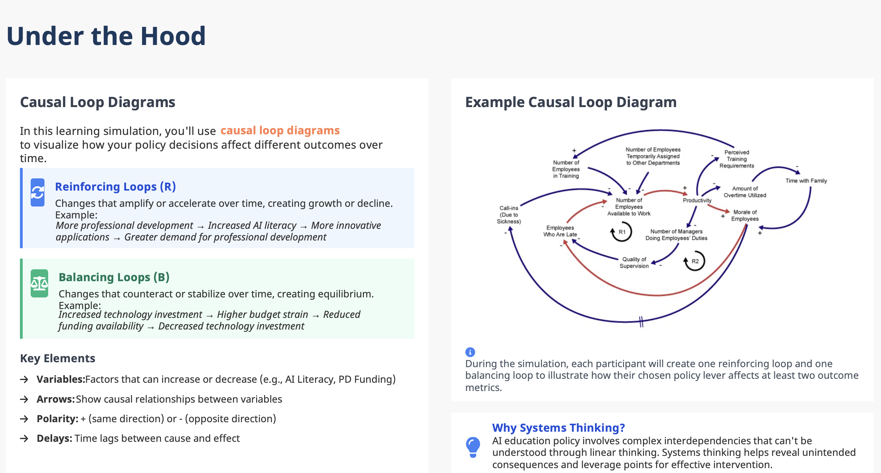
AI Education Policy Simulation
Introduction & Purpose
Facilitator Notes
Explain that in complex systems like AI governance in education, cause and effect are rarely linear - actions create chains of consequences that often circle back. Use a simple, relatable example first and avoid jumping straight into AI policy.
Reinforcing loops show how success or problems can compound over time, while balancing loops reveal natural limits that create stability. Clarify these aren’t “good” vs “bad”—balancing loops often maintain healthy equilibrium. Use real-world examples before applying to policy.
Every participant must create feedback loops showing how their chosen policy lever affects at least 2 outcome metrics. Each participant draws both one reinforcing loop AND one balancing loop. Push participants to find secondary and tertiary effects.
Demonstrate the format: Policy Lever → Outcome Metric → Consequence → Next Element → Back to Policy Lever.
Walk through a few complete example slowly. Many participants will want to create simple cause-effect chains rather than true loops. Emphasize the "feedback" - how effects circle back to influence the original policy
Timing: 20 minutes
Designing an AI-Ready District
3

Slide 30
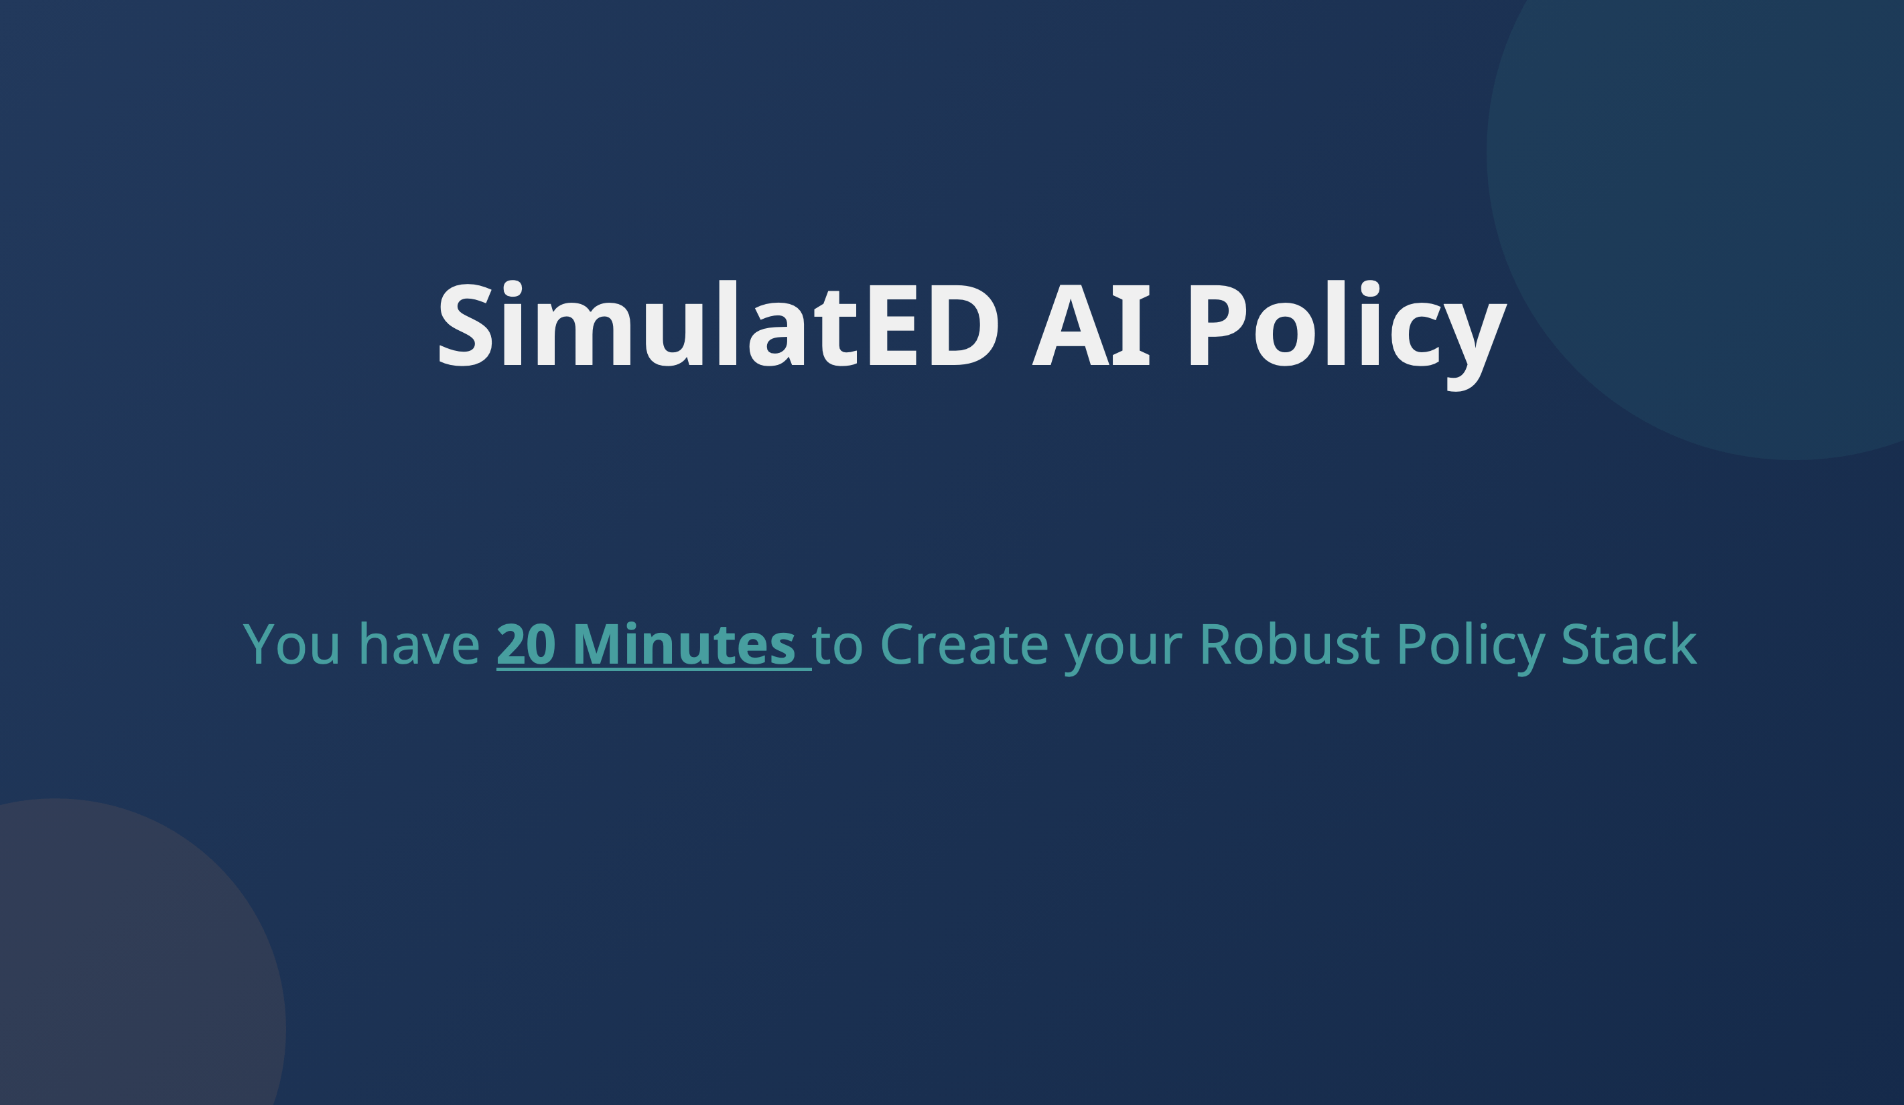
AI Education Policy Simulation
Introduction & Purpose
Facilitator Notes
Move between groups every 3-5 minutes to monitor progress and group dynamics. Don't hover over one group too long. Your presence changes the conversation. Listen for genuine collaboration vs. one person dominating, and note groups that seem stuck or off-track
Ask probing questions: Resist the urge to suggest solutions. Your job is to deepen their thinking, not solve their problems. Questions should make them think harder, not lead them to "correct" answers
Many groups will make decisions based on intuition rather than systematic thinking. Push them to articulate the causal mechanisms they're assuming.
Groups often make decisions based on unstated assumptions about resources, stakeholder cooperation, or external conditions. Making these explicit helps them make better decisions.
Don't smooth over disagreements too quickly - tension often signals important trade-offs. Help groups name and work through competing priorities rather than avoiding them, unless they become unproductive.
Give periodic time warnings but don't rush decisions. Remind district groups they will need to send a representative to present their policy stack, key feedback loops, and reasoning.
Timing: 20 minutes
Designing an AI-Ready District
3

Slide 31
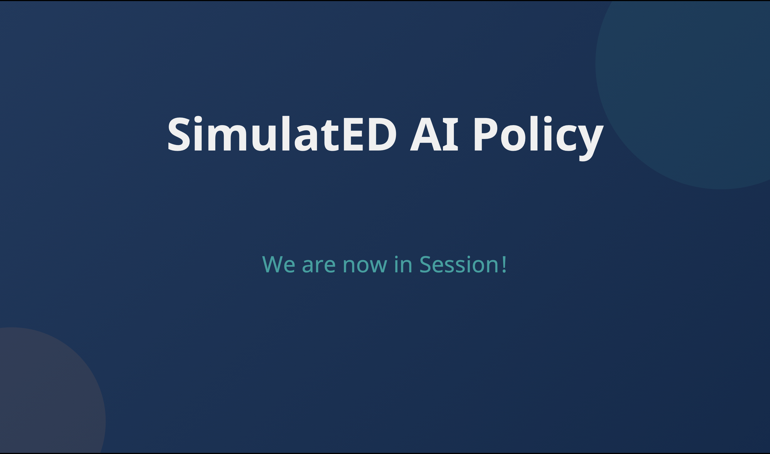
AI Education Policy Simulation
Introduction & Purpose
Facilitator Notes
Each group has 5 minutes (Max) to present their complete policy stack -- selected policy levers, rationale for choices, key feedback loops, and expected metric impacts. This will be followed by 2 minutes of Q&A. Be strict about time limits. Real policymakers must communicate complex ideas concisely. Have a visible timer and give 1-minute warnings to keep presentations focused
Don't let groups just read their policy list. Push them to explain their reasoning and system understanding. The quality of their thinking matters more than their specific choices
Input values into the simulator and make visible the changes in outcome metrics, briefly comment on changes.
Make trade-offs visible to the whole room. Groups often gloss over difficult decisions in presentations. Bringing these to the surface helps everyone learn about policy complexity.
Help participants see they're part of a larger learning community. Pattern recognition across groups reveals important insights about policy dynamics.
Prevent groups from getting defensive about their choices or other groups from attacking decisions. The goal is understanding different approaches, not determining winners
Timing: 25 minutes
Designing an AI-Ready District
3

Slide 32
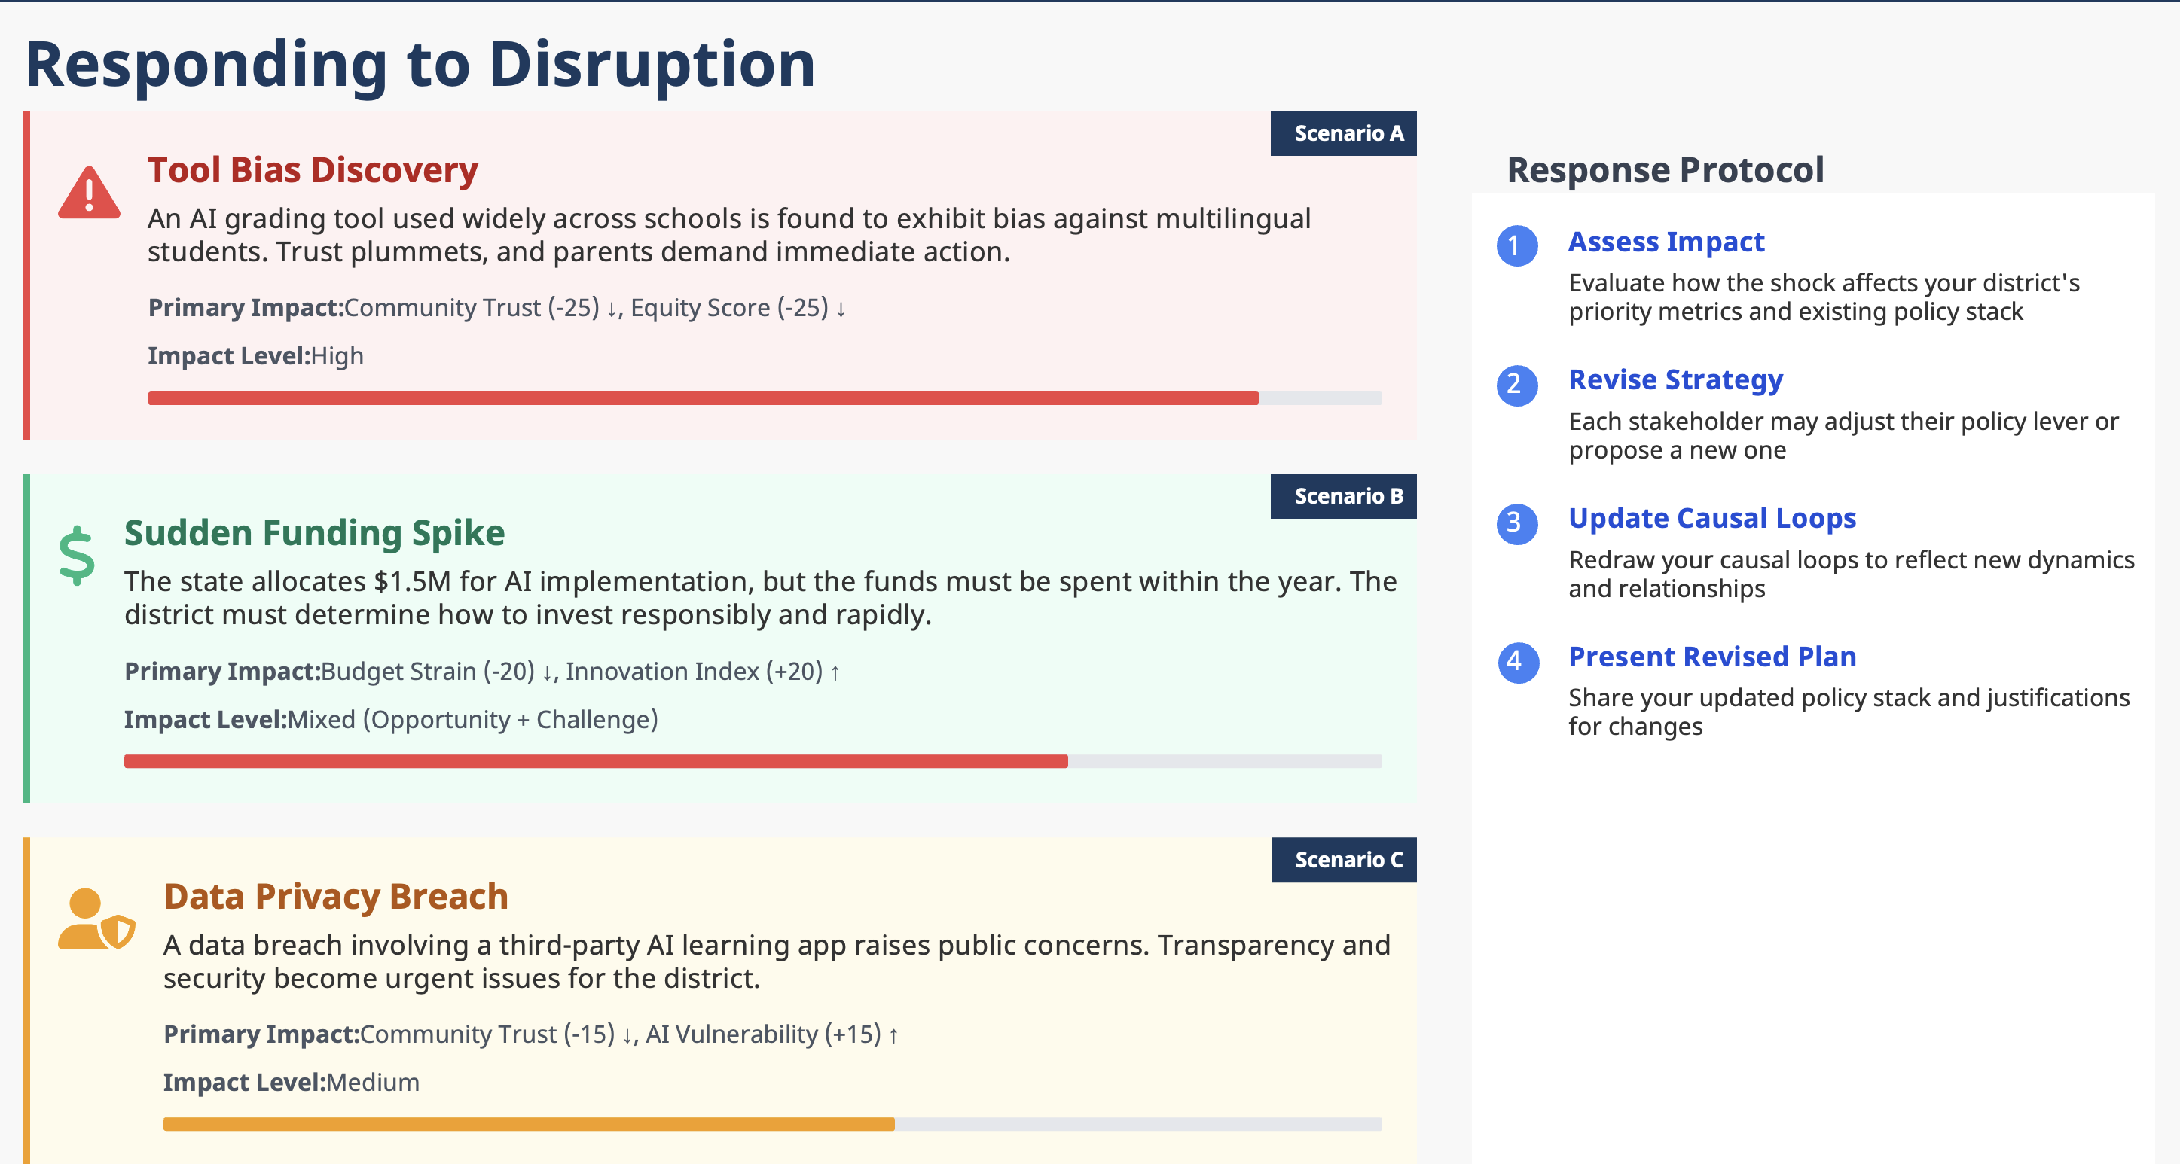
AI Education Policy Simulation
Introduction & Purpose
Facilitator Notes
Explain that all complex systems face unexpected disruptions - the goal is testing resilience and adaptability. Normalize disruption as part of governance. Real districts face budget crises, and sudden opportunities regularly. Frame this as essential leadership practice, not simulation complications.
Assign district groups to shock scenarios. Choose (or create) the scenario that best exposes tensions or blind spots you noticed during presentations. This maintains learning momentum and shows how current decisions shape future vulnerabilities.
Don't present this casually. Use tone and body language to convey that this is a serious disruption requiring immediate strategic response. Help groups feel the pressure real policymakers experience.
Groups have 15-20 minutes to adapt their strategy. Balance time pressure with thoughtful response. Too little time leads to panic; too much time loses urgency. Real crises require quick but strategic thinking.
Timing: 25 minutes
Designing an AI-Ready District
3

Slide 33
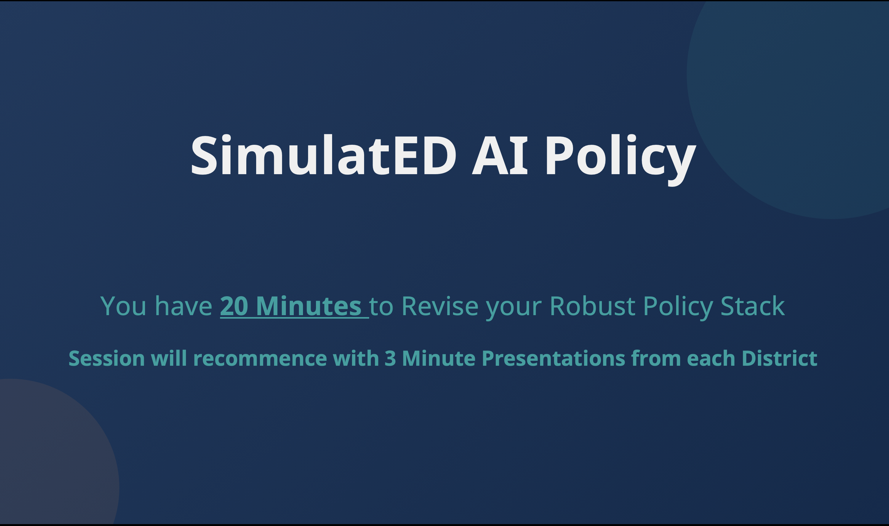
AI Education Policy Simulation
Introduction & Purpose
Facilitator Notes
Groups will look stressed and may ask for guidance - this discomfort is productive learning. our instinct will be to help groups that seem overwhelmed, but crisis decision-making under pressure is a core learning objective. Provide emotional support ("This is hard work") without providing strategic direction
Push groups toward adaptation: "What from your original plan still makes sense given this crisis?” Groups that abandon everything learned poor lessons about path dependency and institutional inertia. Real districts can't start over - they must work within existing systems and stakeholder relationships.
Crisis management requires rapid decision-making with incomplete information. Groups that get paralyzed by analysis need coaching toward action, while groups that react impulsively need encouragement to pause and think strategically.
Timing: 20 minutes
Designing an AI-Ready District
3

Slide 34
AI Education Policy Simulation
Introduction & Purpose
Facilitator Notes
Each group has 3 minutes (Max) to present their revised policy stack. This will be followed by 2 minutes of Q&A. Be strict about time limits. Have a visible timer and give 1-minute warnings to keep presentations focused
Push them to explain their reasoning and system understanding. The quality of their thinking matters more than their specific choices
Input values into the simulator and make visible the changes in outcome metrics, briefly comment on changes.
Same comments as in earlier session.
Timing: 15 minutes
Designing an AI-Ready District
3

Slide 35
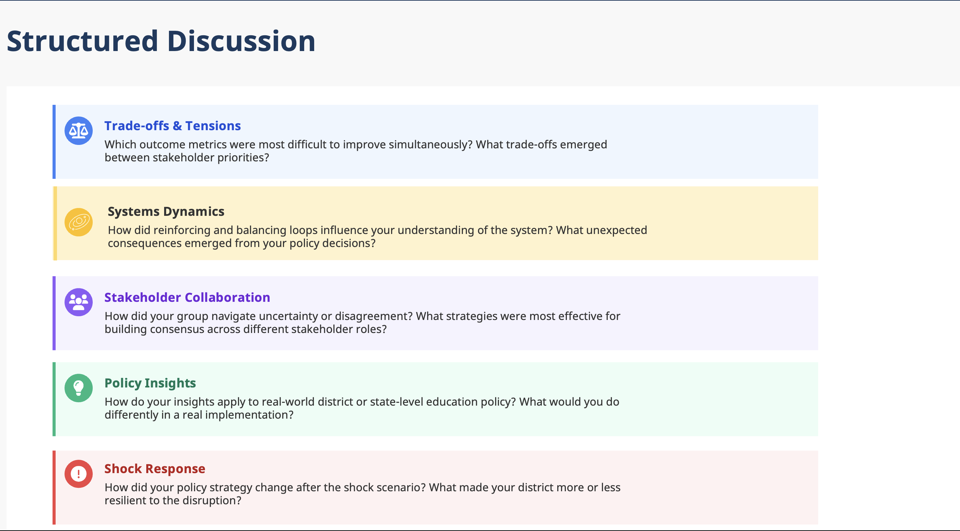
AI Education Policy Simulation
Introduction & Purpose
Facilitator Notes
Participants need to decompress before they can effectively reflect. Don't rush into "what did you learn" - give space for processing the stress and complexity they just experienced. Begin reflection with a ‘Think, Pair, Share’.
Individual group insights become more powerful when connected to patterns across the room. Help participants see they struggled with universal policy dilemmas, not just local problems.
Push beyond surface-level observations to genuine and specific insights about system complexity and policy dynamics.
The collaborative aspect often produces surprising insights about policy complexity and the value of diverse perspectives. Don't let this get lost in technical policy discussion.
Help participants bridge from simulation to reality. The value comes from insights they can use in actual policy work, not just understanding this fictional scenario.
Learning often happens when initial assumptions get challenged. Help participants identify and examine these shifts in understanding.
Timing: 25 minutes
Designing an AI-Ready District
3

